Slide 1
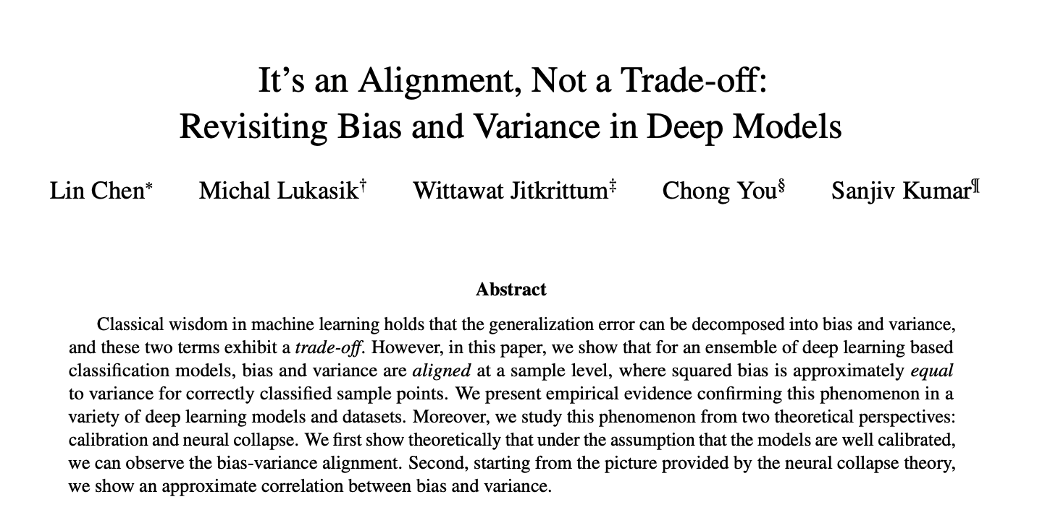
source

Slide 2
Agenda
Background
Bias-Variance decomposition
Bias-Variance alignment
Empirical Finding
Calibration
Neural Collapse
Summary/thoughts

Slide 3
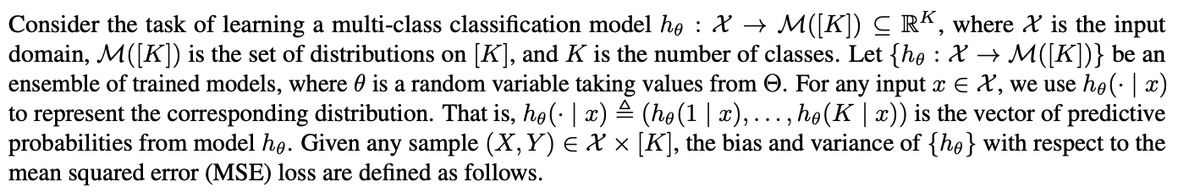
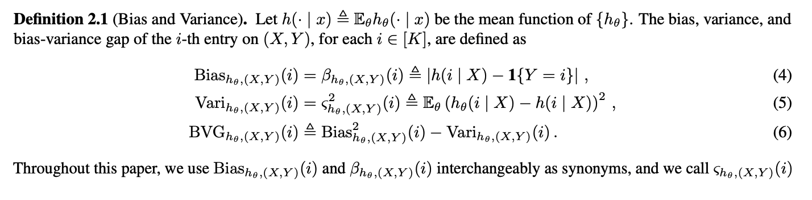
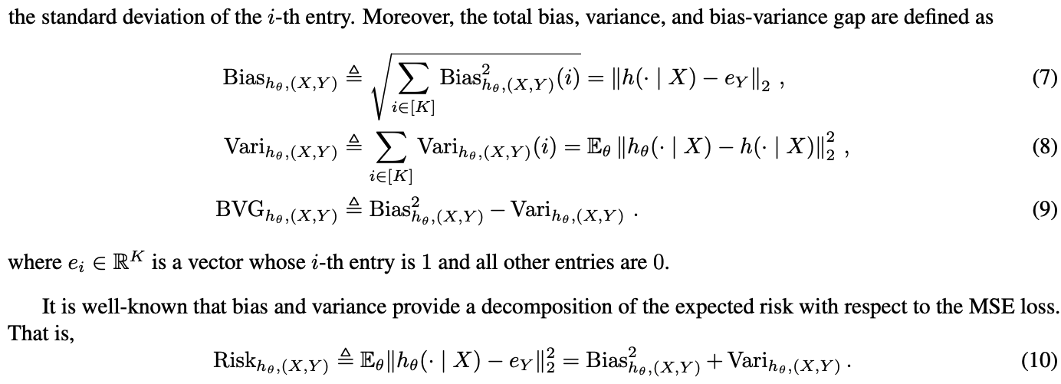
Background

Slide 4
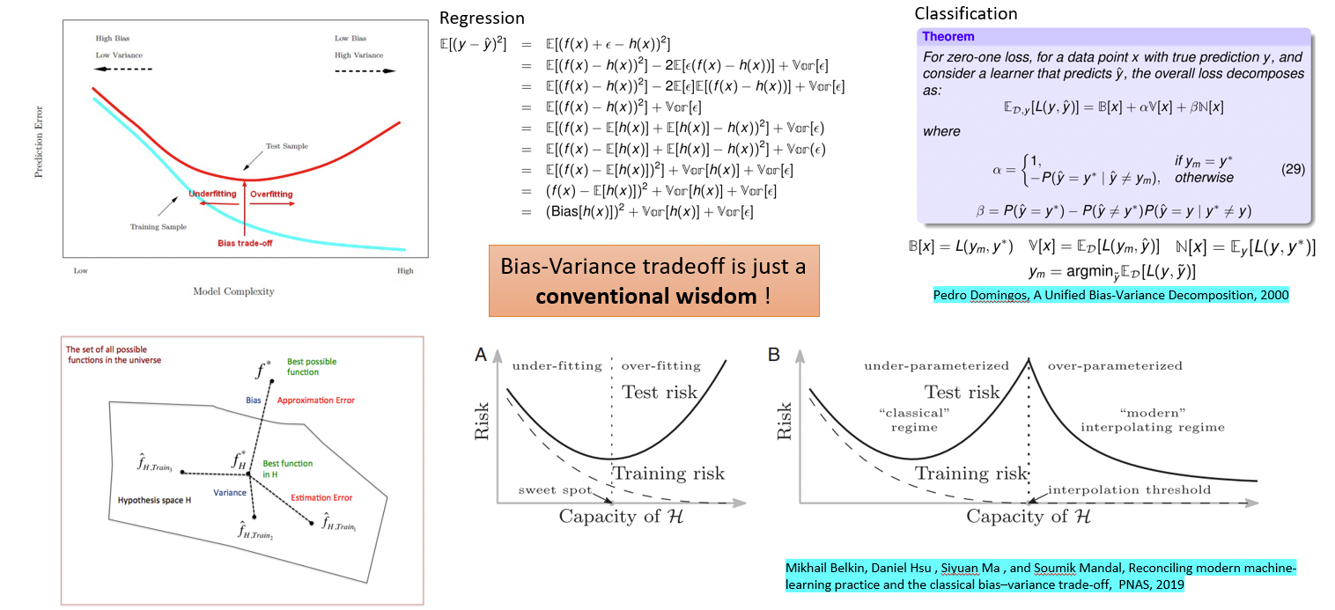
Bias-Variance Decomposition

Slide 5
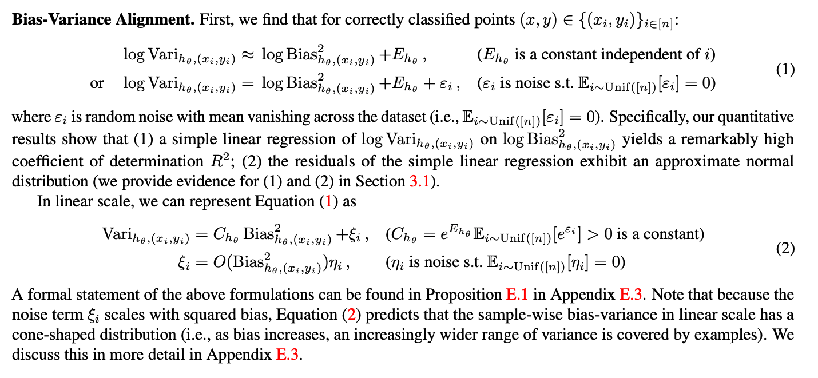
Bias-Variance alignment

Slide 6
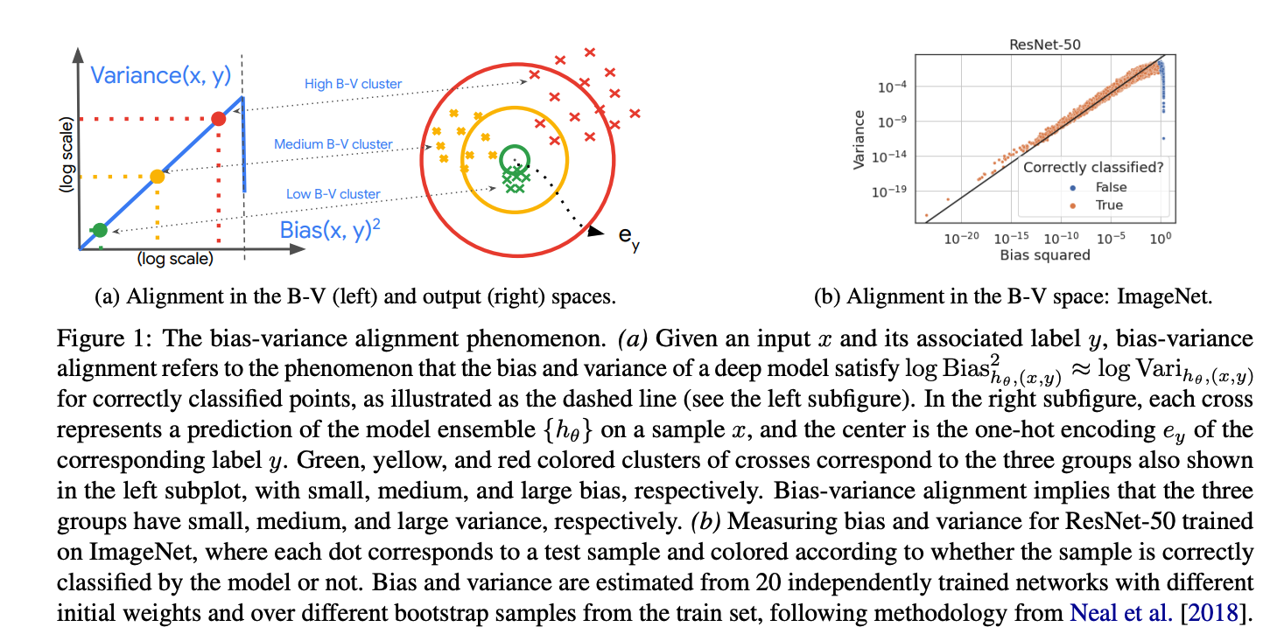
Bias-Variance Alignment

Slide 7
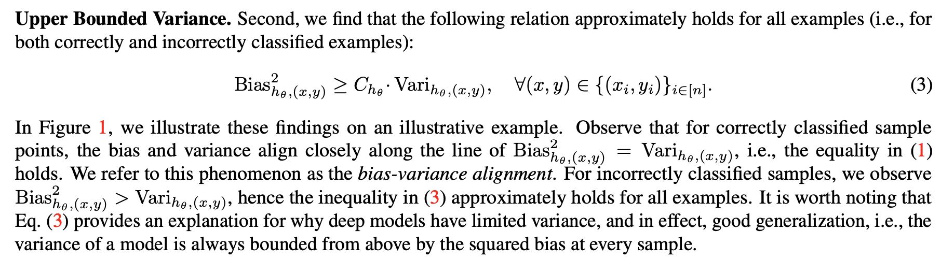
Upper bound variance

Slide 8
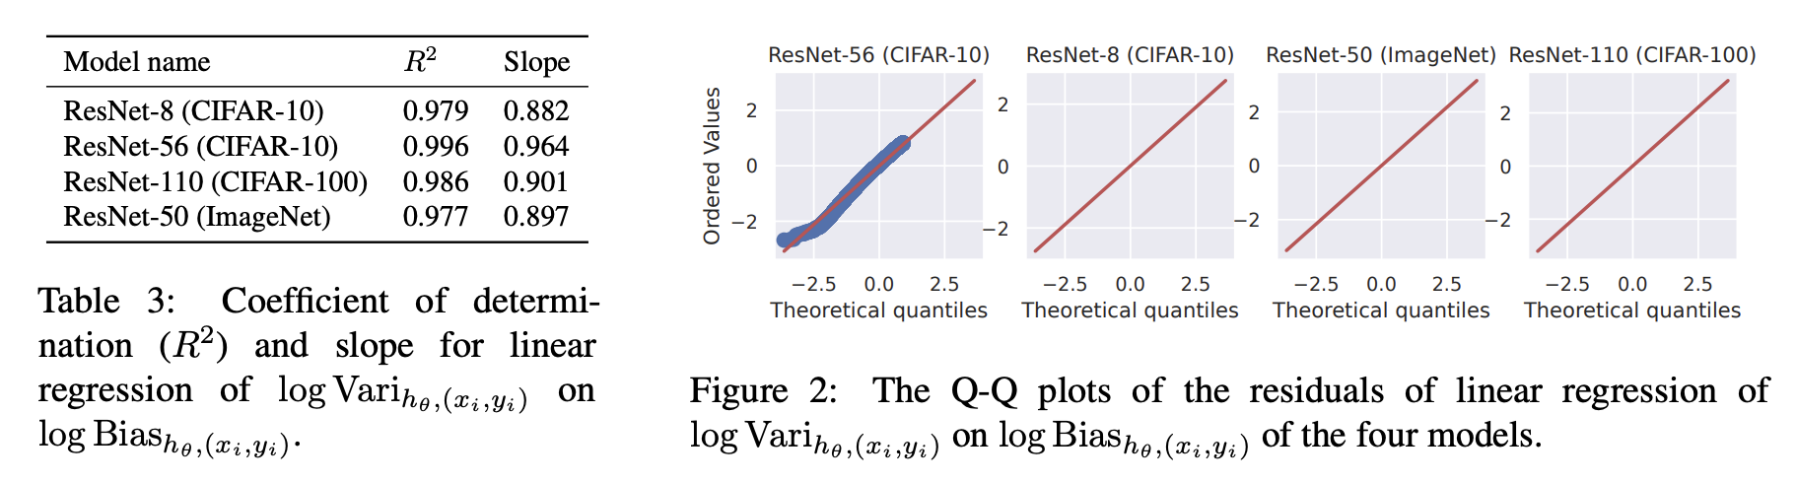
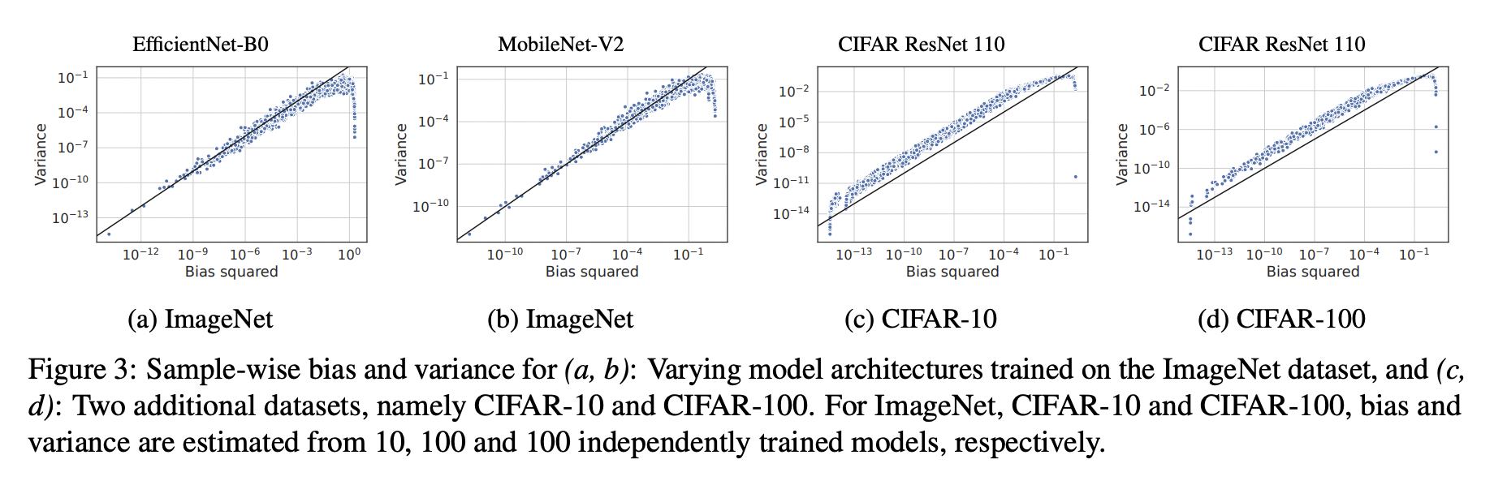
Empirical Findings (1)

Slide 9
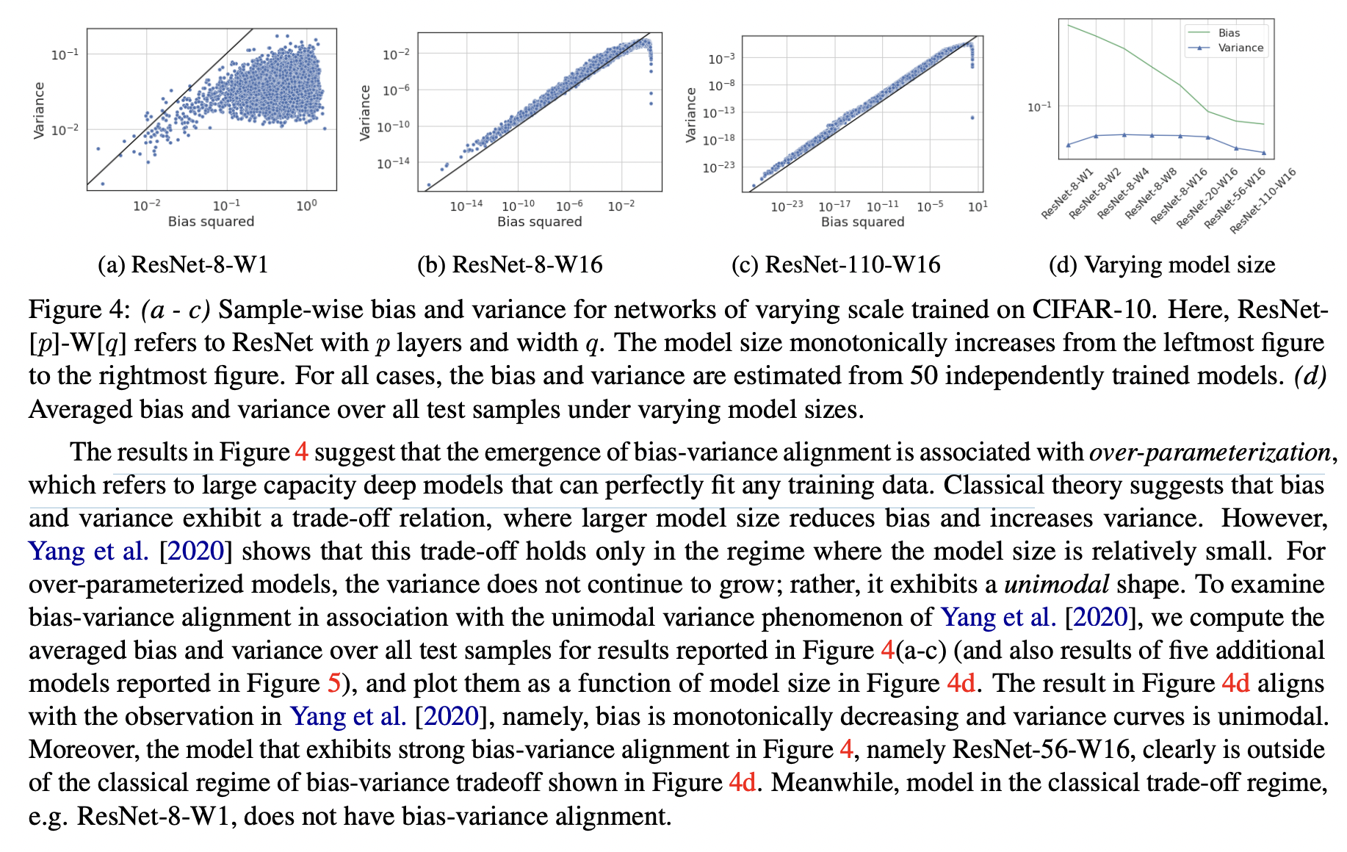
Empirical Findings (2)

Slide 10
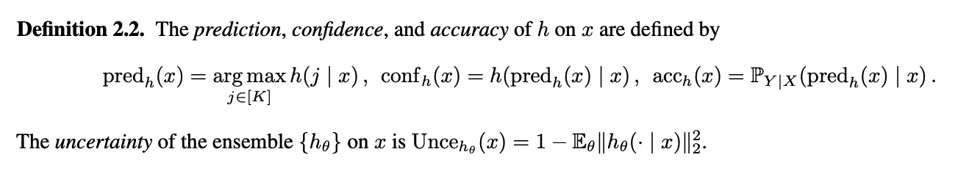
Prediction, Confidence, Accuracy

Slide 11
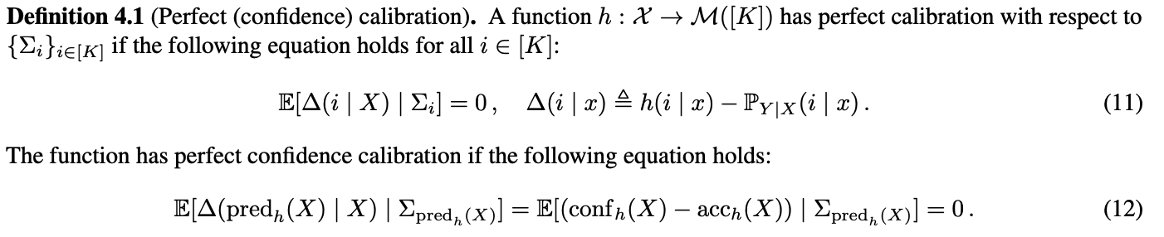
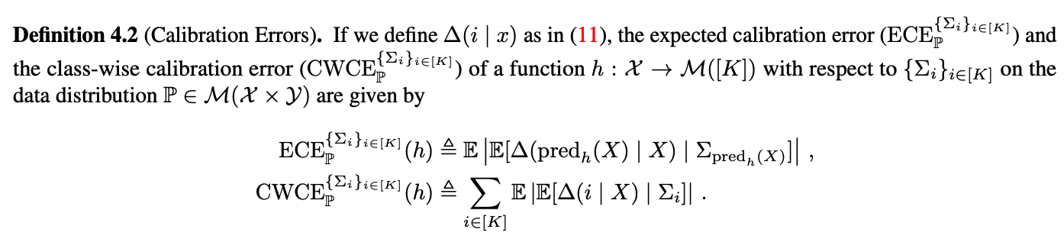
Calibration

Slide 12
Calibration and bias-variance decomposition
Under the model calibration assumption, i.e. the model is well calibrated, there is a correlation between squared bias and variance.
Moreover, in the case of imperfect model calibration, the discrepancy between the squared bias and variance can be bounded by the calibration error.

Slide 13
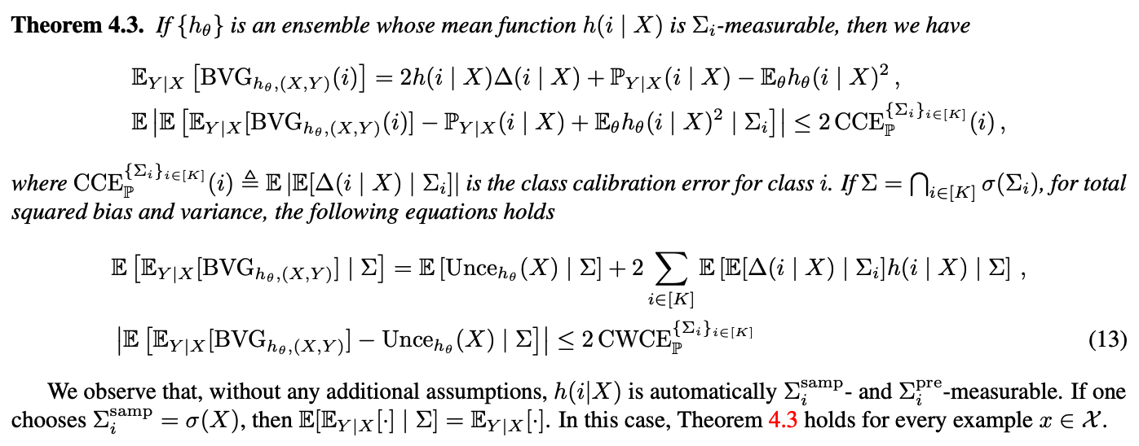
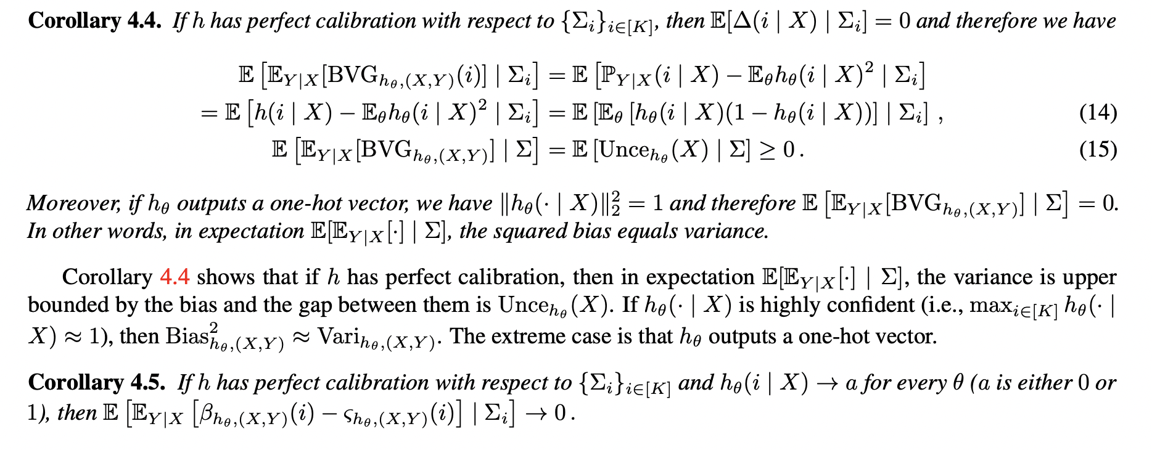
Calibration and BV

Slide 14
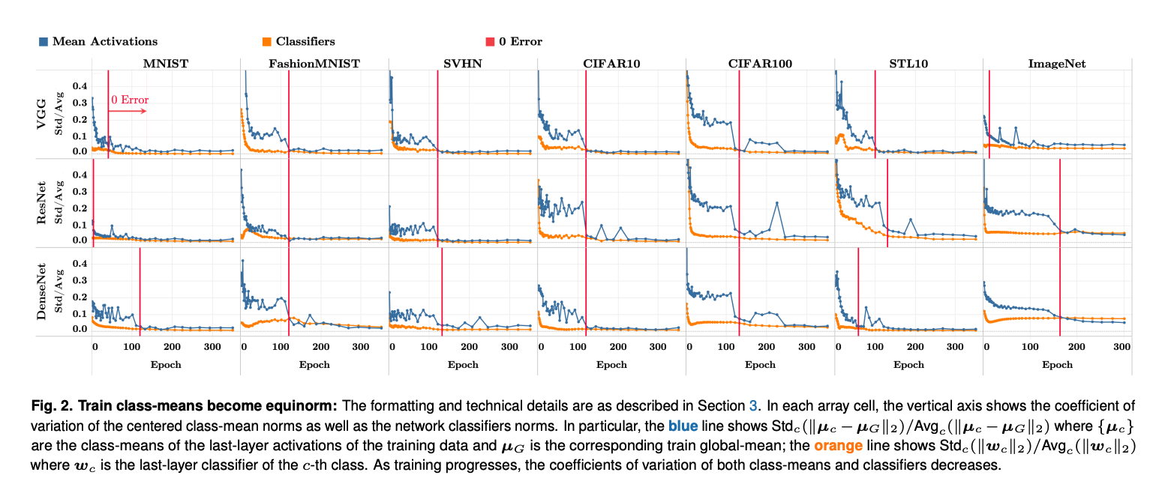
Neural Collapse (1)
Terminal Phase of training (TPT):
Training beyond zero training error
Source: Papyan et al, 2020, Prevalence of Neural Collapse during the terminal phase of deep learning training

Slide 15
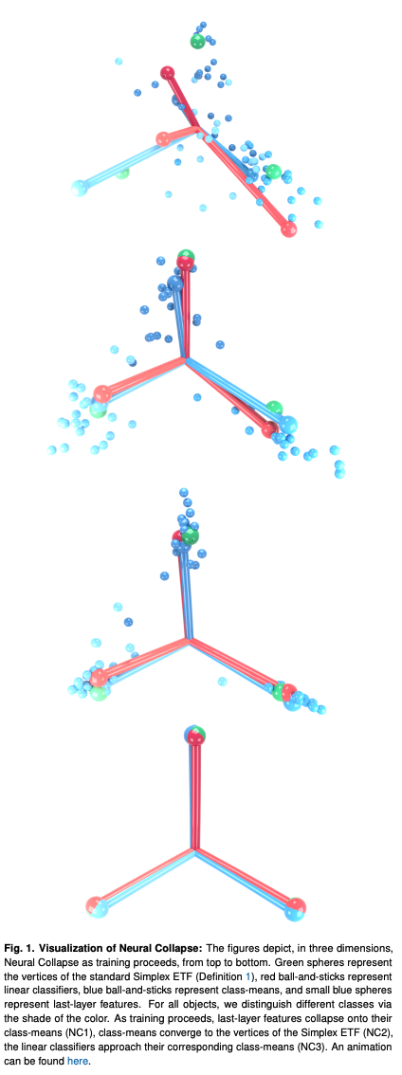
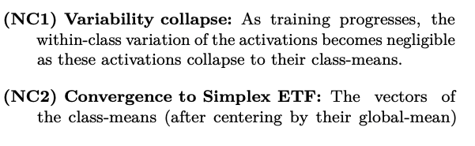
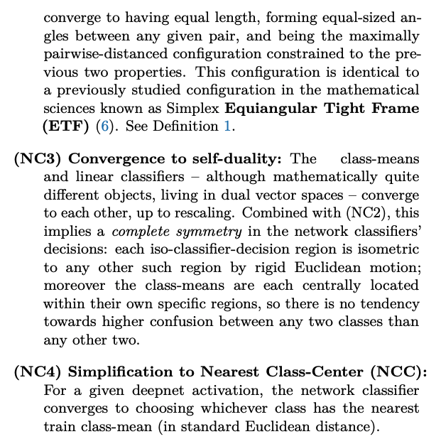
Neural Collapse (2)
Source: Papyan et al, 2020, Prevalence of Neural Collapse during the terminal phase of deep learning training

Slide 16
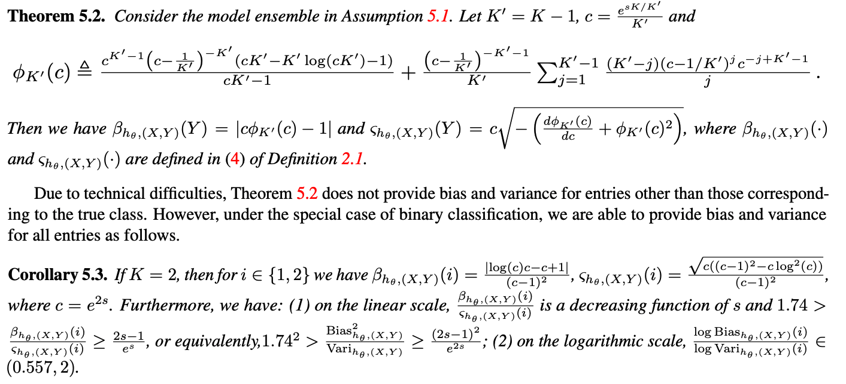
Neural Collapse Implies Approximate Bias-Variance Alignment

Slide 17
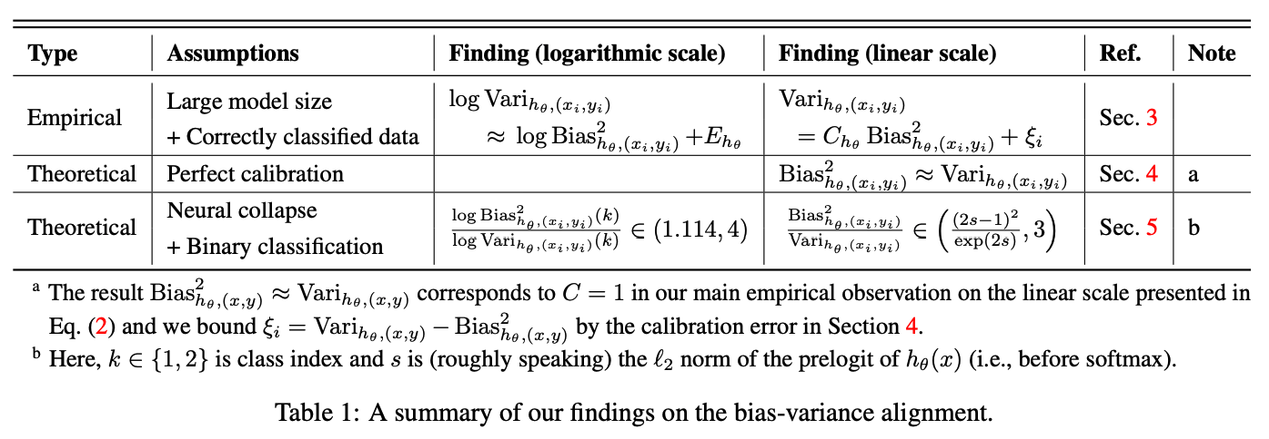
Summary

Slide 18
Reflections
Both well calibrated and neurally collapsed deep networks exhibit a bias-variance alignment or bounded variance which means the network is not severely overfitting and generalizes well.
For non deep neural network , yet fairly complex models, does perfect calibration imply BV alignment ?
E.g. ensemble of trees methods ?
Practical lesson/question : can classifier calibration significantly enhance generalizability ? My guess YES !

